Slide 1


CAMPUS EATS MODEL
GROUP 5
Liam Maxwell
T. J Wallace
Vathsavi Venkat
Yash Patel

Slide 2
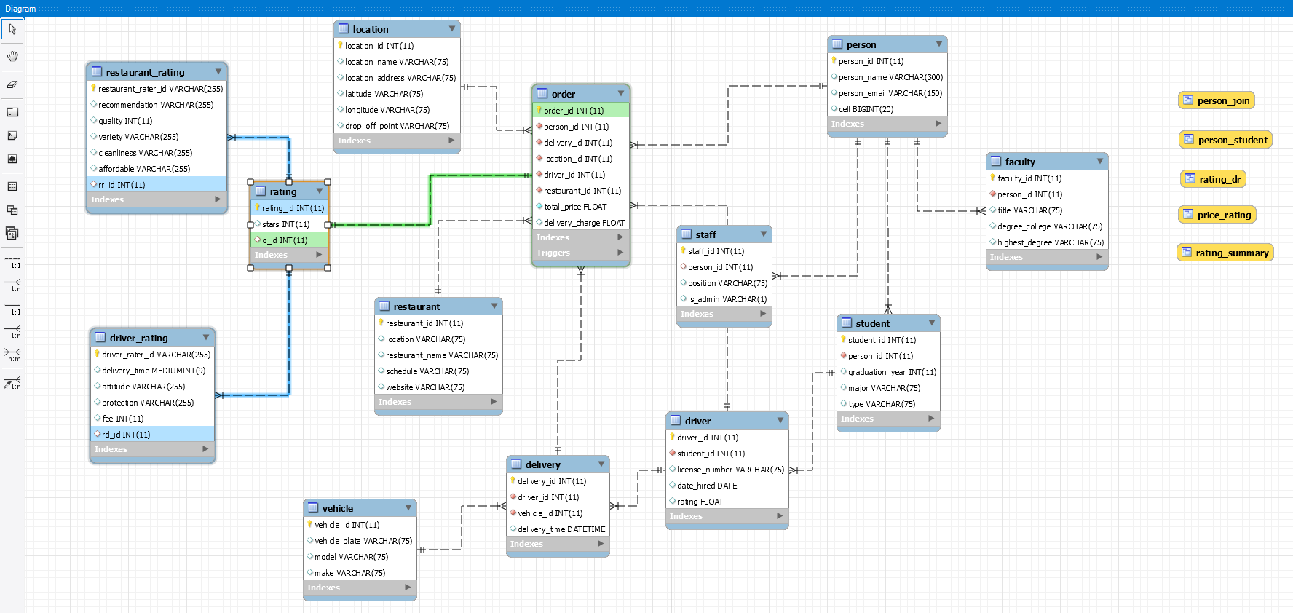
MODEL

Slide 3
CREATE TABLE CODE - RATING
CREATE TABLE `rating`
( `rating_id` int NOT NULL,
`stars` int DEFAULT NULL,
`o_id` int DEFAULT NULL,
PRIMARY KEY (`rating_id`),
KEY `fk_R_order_id` (`o_id`),
CONSTRAINT `fk_R_order_id` FOREIGN KEY (`o_id`) REFERENCES `order` (`order_id`)
);

Slide 4
CREATE TABLE CODE – DRIVER_RATING
CREATE TABLE `driver_rating`
( `driver_rater_id` varchar(255) NOT NULL,
`delivery_time` mediumint DEFAULT NULL,
`attitude` varchar(255) DEFAULT NULL,
`protection` varchar(255) DEFAULT NULL,
`fee` int DEFAULT NULL,
`rd_id` int DEFAULT NULL,
PRIMARY KEY (`driver_rater_id`),
KEY `fk_DR_rating_id` (`rd_id`),
CONSTRAINT `fk_DR_rating_id` FOREIGN KEY (`rd_id`) REFERENCES `rating` (`rating_id`)
);

Slide 5
CREATE TABLE CODE – RESTAURANT_RATING
CREATE TABLE `restaurant_rating`
( `restaurant_rater_id` varchar(255) NOT NULL,
`recommendation` varchar(255) DEFAULT NULL,
`quality` int DEFAULT NULL,
`variety` varchar(255) DEFAULT NULL,
`cleanliness` varchar(255) DEFAULT NULL,
`affordable` varchar(255) DEFAULT NULL,
`rr_id` int DEFAULT NULL,
PRIMARY KEY (`restaurant_rater_id`),
KEY `fk_RR_rating_id` (`rr_id`),
CONSTRAINT `fk_RR_rating_id` FOREIGN KEY (`rr_id`) REFERENCES `rating` (`rating_id`)
);

Slide 6
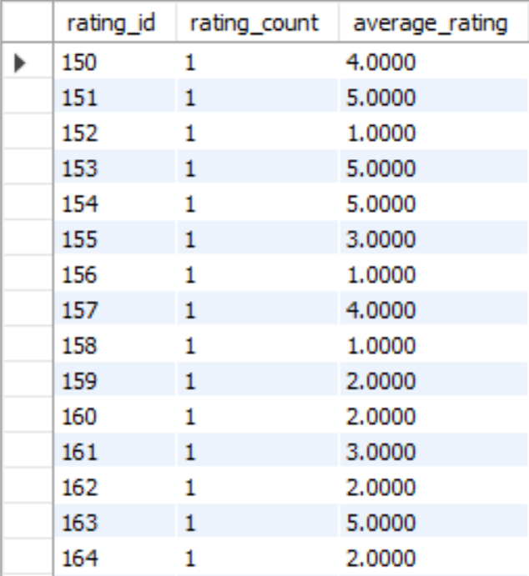
VIEW 1
CREATE VIEW rating_summary AS
SELECT rating_id,
COUNT(*) AS rating_count,
AVG(stars) AS average_rating
FROM rating r JOIN `order` o
ON r.o_id = o.order_id
GROUP BY rating_id;
SELECT * FROM rating_summary;

Slide 7
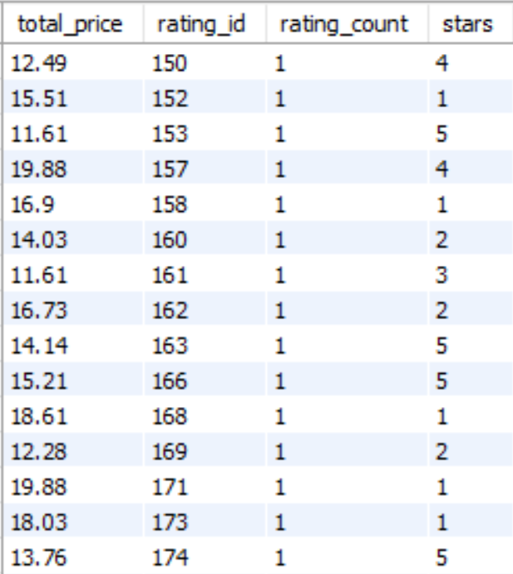
VIEW 2
CREATE VIEW price_rating AS
SELECT o.total_price, rating_id,
COUNT(*) AS rating_count, stars
FROM rating r JOIN `order` o
ON r.o_id = o.order_id
WHERE o.total_price > 10
GROUP BY rating_id;
SELECT * FROM price_rating;

Slide 8
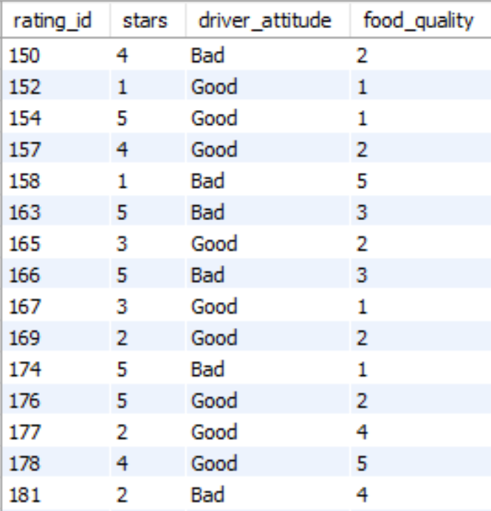
VIEW 3
CREATE VIEW rating_dr AS
SELECT rating_id, stars,
attitude as driver_attitude,
quality as food_quality
FROM rating r, `order` o, driver_rating d, restaurant_rating rr
WHERE r.o_id = o.order_id
AND d.rd_id = r.rating_id
AND rr.rr_id = r.rating_id
GROUP BY rating_id
ORDER BY rating_id;
SELECT * FROM rating_dr;

Slide 9
INDEXES
Location
PRIMARY Location_index_desc Idx_location_location_name
Vehicle
PRIMARY
Restaurant
PRIMARY
Order
PRIMARY Fk_O_person_id Fk_O_delivery_id Fk_O_Location_id Fk_O_driver_id Fk_O_restaurant_id
Driver
PRIMARY Fk_D_student_id
Delivery
PRIMARY Fk_delivery_driver_id Fk_delivery_vehicle_id

Slide 10
INDEXES [CONTINUED…]
Person
PRIMARY
Staff
PRIMARY Fk_S_person_id
Rating
PRIMARY
Faculty
PRIMARY Fk_F_person_id
Student
PRIMARY Fk_St_person_id
Driver Rating
PRIMARY
Restaurant Rating
PRIMARY

Slide 11

THANK YOU!

